Slide 1
Ancient Rome
Geography

Slide 2
What type of work did the Ancient Romans do?
Let’s remember that Ancient Rome was located on the Mediterranean Sea. The city itself was located next to a river amongst many hills.
The type of work the Ancient Romans did was related to their physical geography.
Notes:
Do you remember what type of work the Ancient Greeks did?

Slide 3
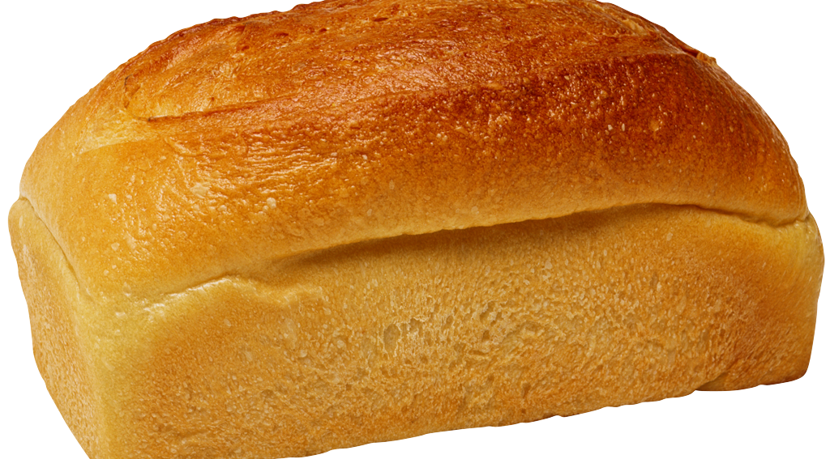
Ancient Romans were farmers.
Notes:
Questions to ask: What does it mean to be a farmer? What types of things do you think the Ancient Romans farmed? What do farms normally look like? Are farms usually flat or hilly? Do you think you’d have trouble farming on the hillsides like the Ancient Romans did? The Ancient Romans had limited rich soil and had to learn to adapt to their environment by farming on the hillsides around Rome.

Slide 4
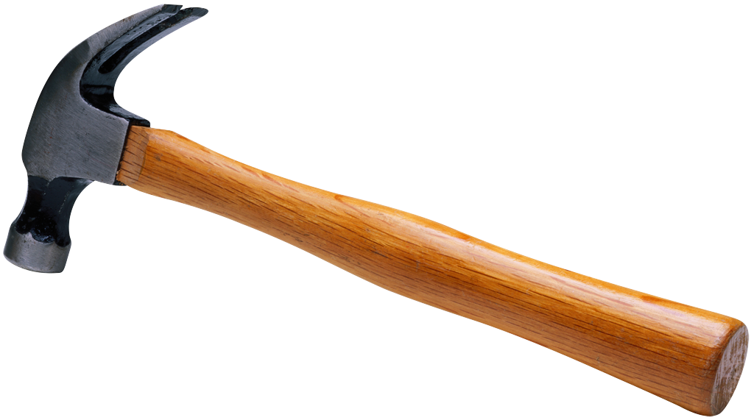
Ancient Romans were road builders.
Notes:
Questions to ask: What does a road builder do? Why is having roads so important? How do you think the roads in Ancient Rome compared to our roads today? The Romans built roads connecting them to the hills and waterways around them. This allowed them to travel and trade with others in the area.

Slide 5
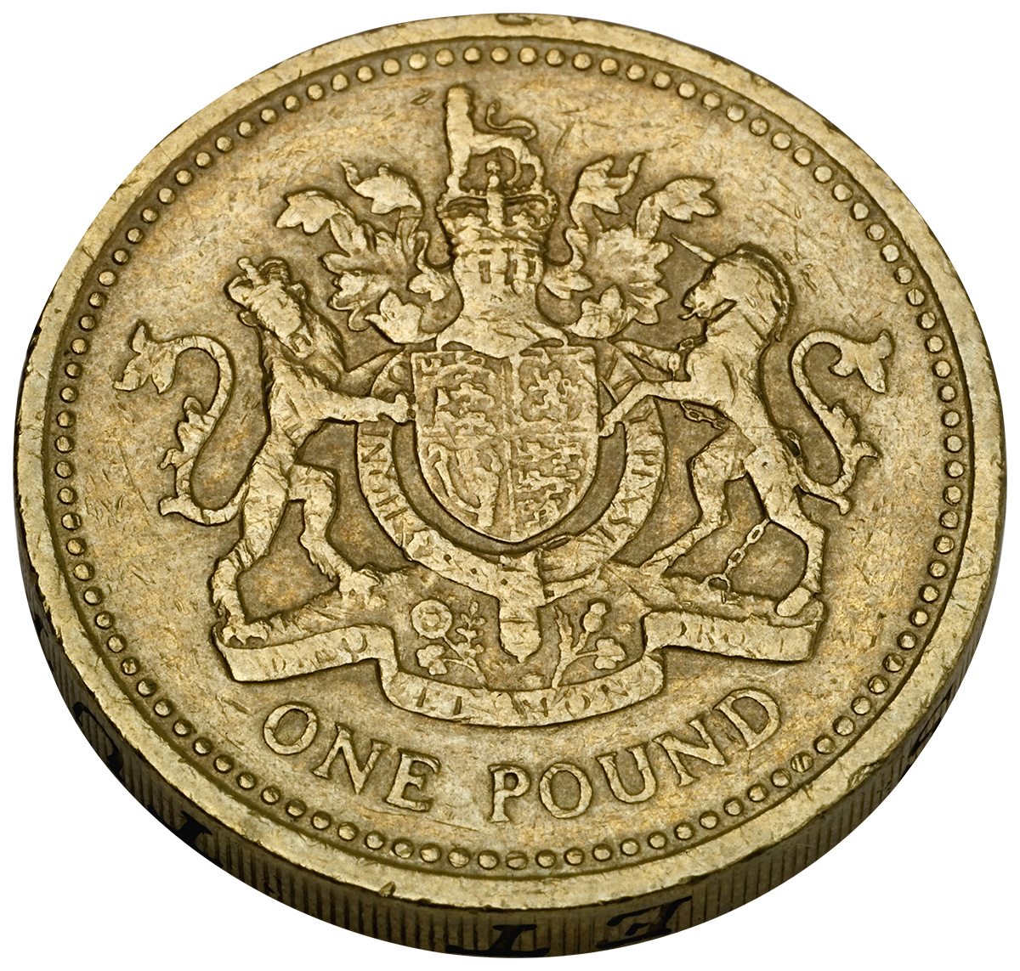
Ancient Romans were traders.
Notes:
Questions to ask: What does it mean to be a trader? What sorts of things do you think the Ancient Romans traded? What does trade look like in our society today? Who do you think the Ancient Romans traded with? The Ancient Romans were located next to a large body of water called the Mediterranean Sea. They adapted to their environment by building ships and learning to trade on the sea.

Slide 6
Think-Pair-Share
How did the Ancient Romans adapt to their environment?
Notes:
Students should turn to their partner and discuss the question for two minutes.

Slide 7
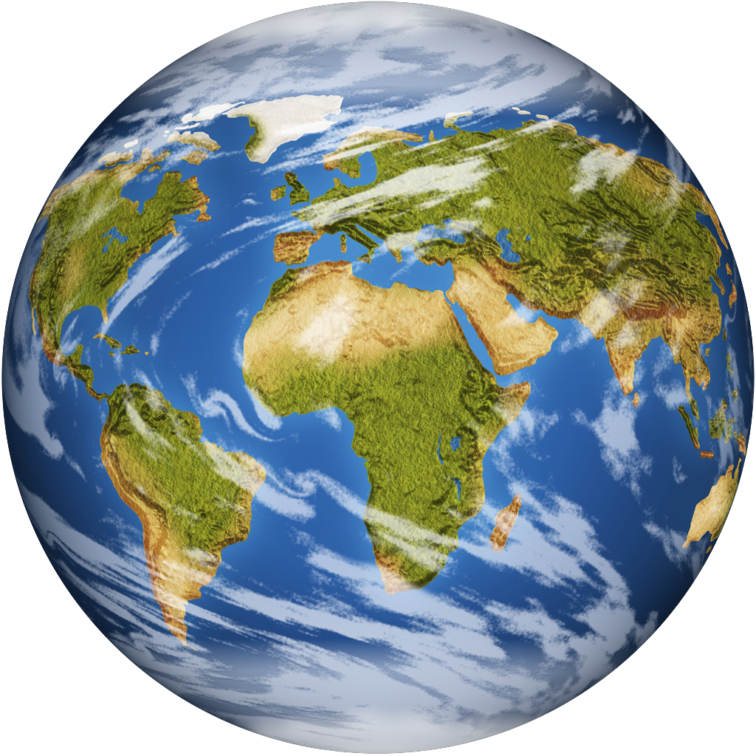
Do you have any connections?

