Slide 1
Ancient Rome
So How Do We Know About the Ancient Romans?

Slide 2
What contributions did the Ancient Romans make to us?
Notes:
The key contributions you’re looking for are ‘representative democracy’ and ‘arches’. Ask: “What building is this? Have any of you ever seen this before? What happens here that is important to the U.S.? How did the Ancient Romans influence what happens here?” Ask: “What is the second picture? What contribution do you see here? Why is knowing how to build things so important to the U.S. today?”

Slide 3
Think-Pair-Share
What do you think is the most important contribution of the Ancient Romans? Why?
Notes:
Have students discuss this question with a partner for 1-2 minutes.

Slide 4
How Do We Know About the Ancient Romans?
Notes:
We know about the Ancient Romans through their writing/letters, art and architecture, and archeology. Ask: “What do you think writing and letters can tell us about the Ancient Romans? What can archeology tell us? What can art and architecture tell us?” Let’s think back to their government and geography: What do these things tell us about the lifestyle of the Ancient Romans?

Slide 5
Think-Pair-Share
In 100 years from now, how will historians know about you?
Notes:
Have students discuss with a partner for 1-2 minutes.

Slide 6
Rome
U.S.
Greece
Notes:
This shows what students should have on their Triple Venn Diagram worksheets. Re explain how Venn Diagram work if necessary and your expectations for the assignment. Students should strive to get 1-2 comments in each section.

Slide 7
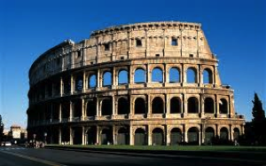
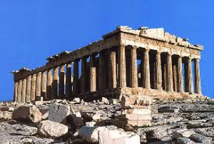
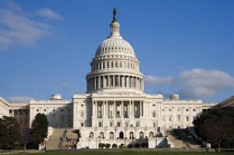
Rome
The Colosseum
Greece
The Parthenon
U.S.
The U.S. Capitol Building
Notes:
Here are the three structures they will be comparing on their Venn Diagram worksheet. This slide should be left up throughout the activity. Here are questions students could ask to help them compare and contrast: “How are they alike? How are they different? Are there arches or columns? What color are they? What size are they? What material are they made of? What texture are they or what do they feel like? What are they used for? Where are they located? What do they symbolize to the people in those societies? How are they important?” These questions can be written on the board to help groups brainstorm ideas.

